Slide 1
From conceptual models to implementations
LRM in user interfaces for search and exploration

Slide 2
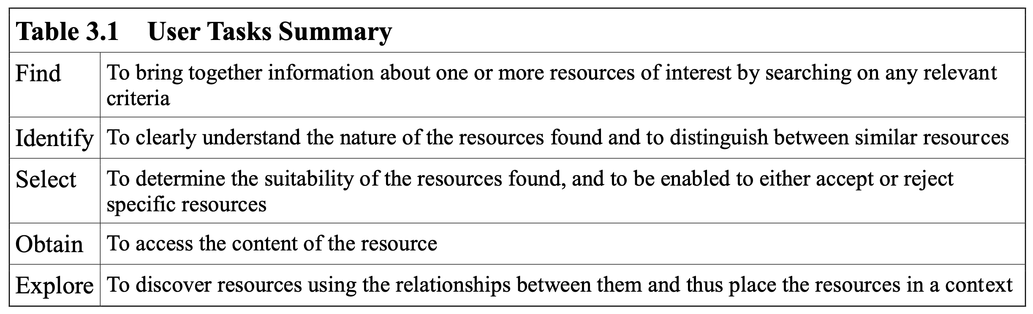
The purpose of models
Models are tools to solve problems
Conceptual models are guides
Implementation models are descriptions
In LRM, the purpose of the model is defined through "user tasks"
...designed to be used in linked data environments and to support and promote the use of bibliographic data in linked data environments

Slide 3
In contrast
BIBFRAME has a primary focus on traditional data exchange:
"A major focus of the initiative is to determine a transition path for the MARC 21 formats while preserving a robust data exchange that has supported resource sharing and cataloging cost savings in recent decades."

Slide 4
Implementing conceptual models
Coding data
Conceptual model as the foundation of formats and vocabularies
Does the model match our data, or make our data better
Interoperability, exchange and reuse
Conceptual model as foundation for exchange and reuse
Within same domain vs. across domain
Easier to agree on the intention than the extension
Identity management
Applications
Conceptual model as foundation for good user experience
Final test: do the model match or conflict with user's conceptualization

Slide 5
How do we know the quality of a model?
Conceptual models are often expert-driven
Knowledge and expertise as main input
Reviewing as validation
Semantic quality
The model is a complete and correct representation of a domain, captures all relevant statements we need to express in a domain
Pragmatic quality
The model can be understood by all actors that will use the model
We also need to consider "Application quality"
Validating the model by implementing and testing it
How does it perform on user tasks
Lindland et al. (1994) Understanding Quality in Conceptual Modeling. IEEE Software 11(2).

Slide 6
Search interfaces
A changing landscape of features and user expectations
Full text indexing and ranking
Users expect relevant items on top of list
Interactivity
The search is merely the first step
That can be refined by filtering, sorting, other interactions
Exploring
Finding cues that can be explored (by navigation)
Users learn and adapt
But not if the model and presentation conflicts with user expectations

Slide 7
LRM and the grouping of results
Was early identified as a main feature of FRBR/LRM
To compact and reduce the size of result listings
More comprehensible presentation
Is already a feature in many bibliographic systems
Groups that represent alternative versions
Mostly based on common key information such as author, titles
But rarely based on "true" LRM
…also found in other systems
LibraryThing, Amazon, ...

Slide 8
Different models give different graphs
William Golding’s Lord of the Flies, translations and movie adaptations
BIBFRAME alternatives + LRM (rightmost)
Aalberg, Trond; Tallerås, Kim; Massey, David. (2019) The impact of new bibliographic models on the search experience. Information research

Slide 9
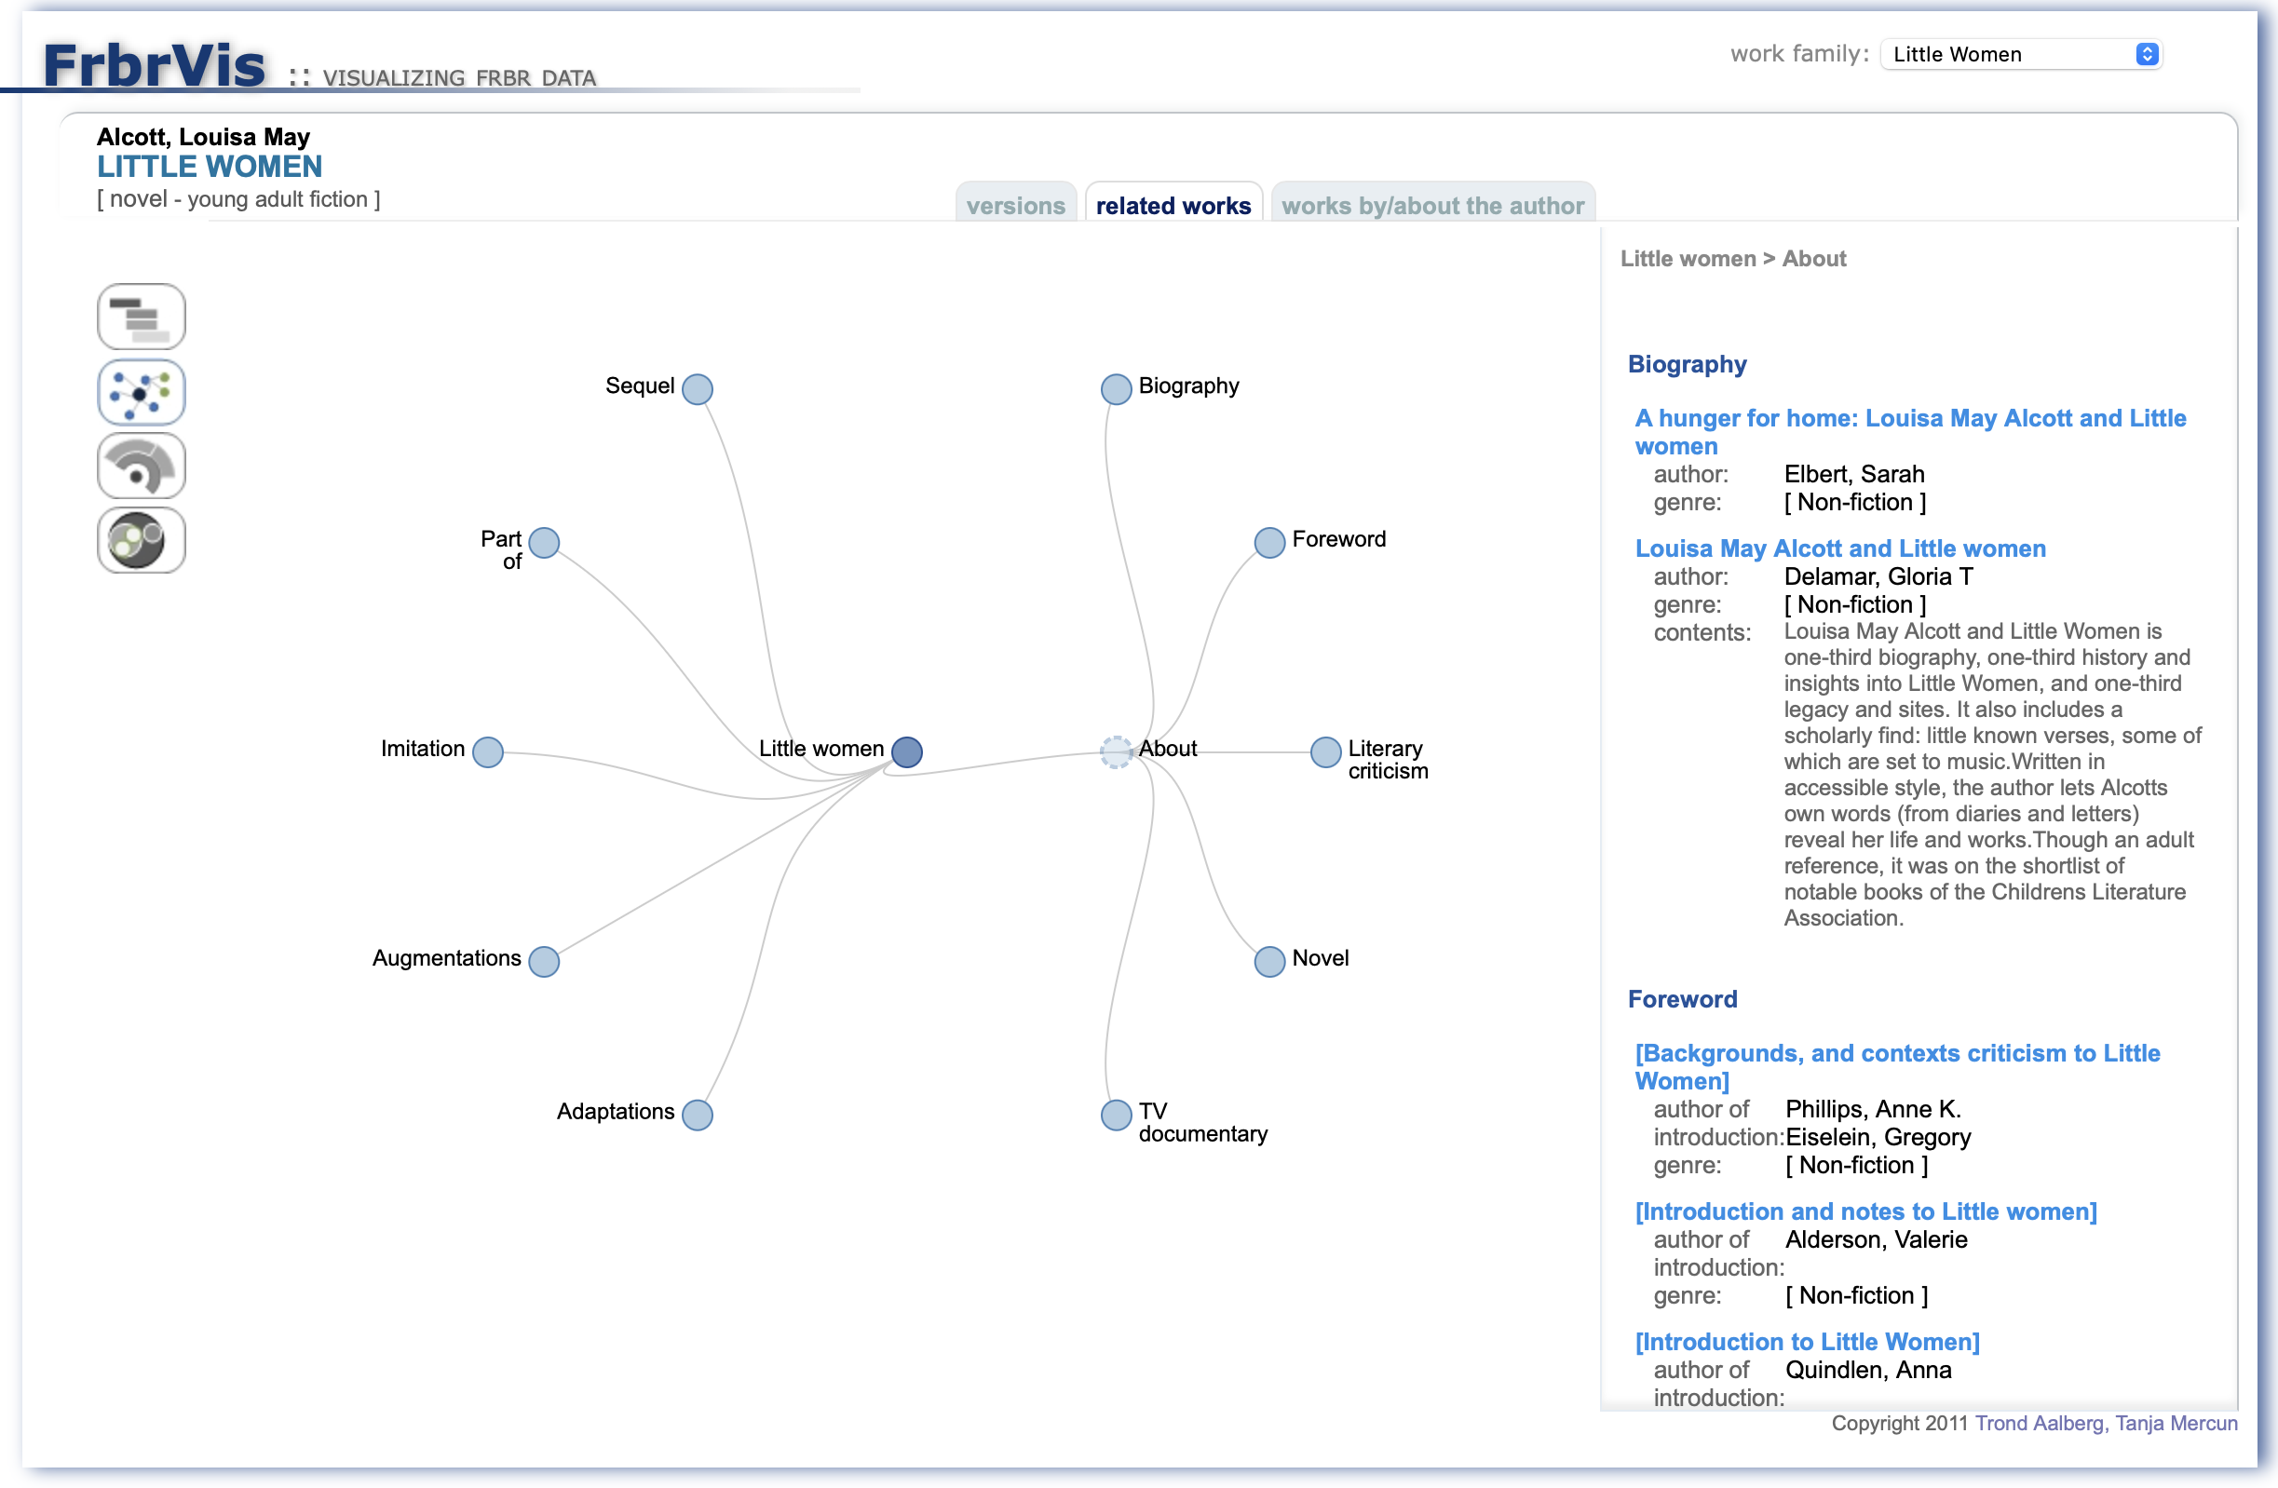
Exploring WEMI search and display
Earlier work on visualizations
Graphs are difficult to present in user interfaces
Visualizations of nodes and links
Uncommon interface for users
Difficult to combine graphs and text
List-based remains the most convenient presentation
Merčun, Tanja; Žumer, Maja; Aalberg, Trond. (2017) Presenting bibliographic families using information visualization: Evaluation of FRBR-based prototype and hierarchical visualizations. Journal of the Association for Information Science and Technology

Slide 10
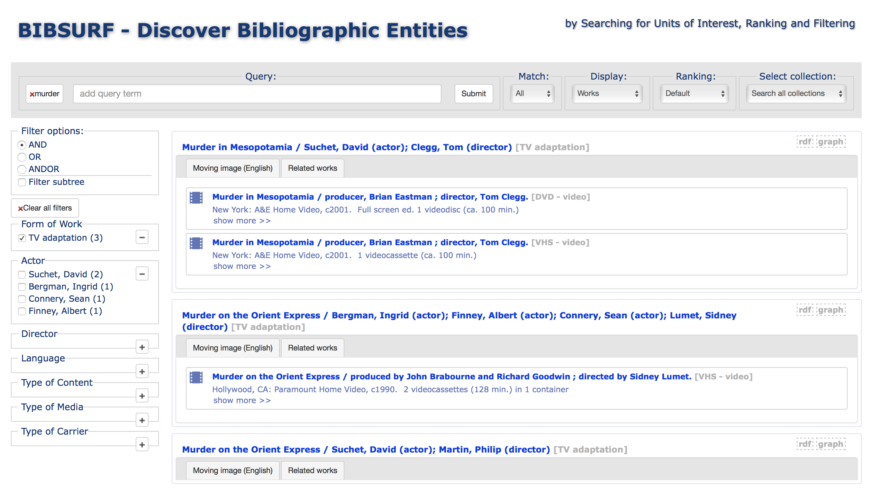
Hierarchical displays
Aalberg, Trond; Mercun, Tanja; Zumer, Maja. (2017) Interactive displays for the next generation of entity-centric bibliographic models. Lecture Notes in Computer Science

Slide 11
What entity type to display?
Explicit representation of all WEMI entities requires support for multi-level listings
Has proven useful, but different entities serve different user needs
WEM(I) entity types as different focus points in the graph

Slide 12

Expression centric displays
Aalberg, Trond; Zumer, Maja; Riva, Pat. (2024) Presenting Compounds to End Users in Search Results. Cataloging & Classification Quarterly

Slide 13
Content vs. carrier
Main feature of LRM is that it enables the description of content
As distinct expression entities
One manifestation embodies one or more expressions
Expression is (probably) the most central entity
But still many issues to address
Not all expressions are equally interesting as individual entries in results
Many expressions only occur once in a collection
How and when to present same-entity type relationships
The language of labels and target titles when presenting links

Slide 14
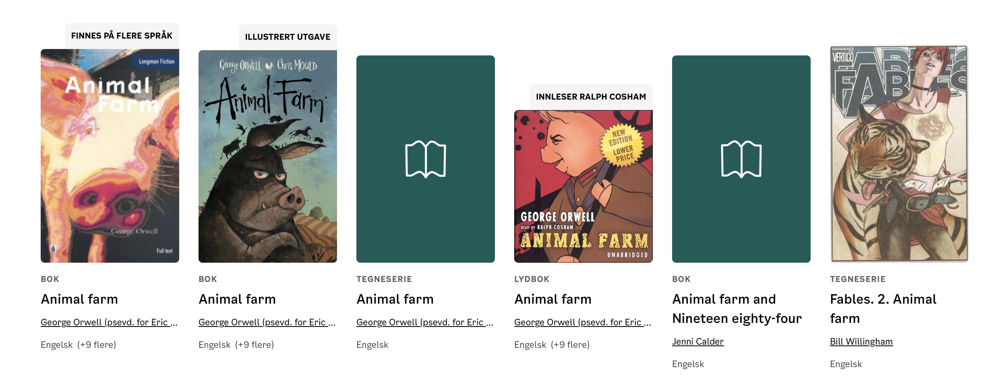
Do LRM-based result listings match user needs?
User needs are many and unpredictable
The Norwegian public library deichhman.no explores grouping based on "content uniqueness"

Slide 15

But also cases of "good" match with LRM
https://www.idagio.com

Slide 16

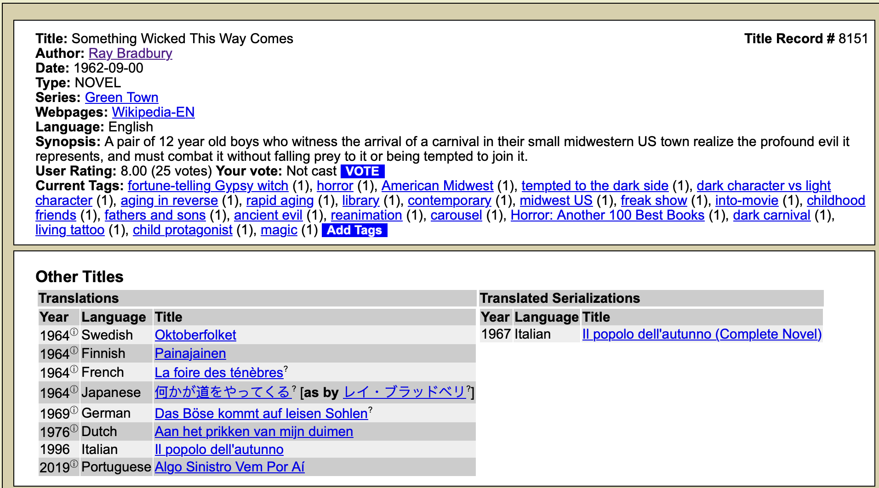

Slide 17
The entity-based user experience
Users should not need to be aware of the model
Final test is if the presentation matches user expectation
Any model is a tool, and should be evaluated in the context of use
Data representation, data exchange and reuse, user applications
Using LRM to implement search and exploration
A well defined model is a req for implementing well designed interfaces
Unambiguous, consistent, interpretable data
The value is in the data

Slide 18

Still much to learn and explore
Path from model to implementation is paved with best practices
That are not yet developed nor evaluated…

